Slide 1

Eclipse EMF
Trainer name
City and date

Slide 2
About me: Ralf Ebert
Professional Java developer for 5 years
Primarily specializing in client-side development
    Web Applications
    Rich client applications
    Human-Computer Interaction and UI design
Consulting for a large German trading group:
Swing to Eclipse RCP migration project
User of Eclipse IDE for 4 years
ebert@weiglewilczek.com

Slide 3
About me: Ilya Shinkarenko
Software engineer / Consultant at Weigle Wilczek GmbH
      Java EE, Eclipse
      HCI, Usability
10 years of professional development
      Sun Certified Java Programmer
      Certified JBoss Developer
3+ years of Eclipse development
      >10 Eclipse-based projects
      Workshops, Seminars, Consulting
      Eclipse RCP Training concept
shinkarenko@weiglewilczek.com

Slide 4
About me: Alexander Thurow
Training / Coaching
Software engineer at Weigle Wilczek GmbH
6 years of Java development
    JEE on JBoss AS
4 years of Eclipse IDE
2 years of Eclipse RCP development
    Involved in 3 ongoing RCP projects
thurow@weiglewilczek.com

Slide 5
About me: Aleksey Aristov
Senior Software Architect at Weigle Wilczek GmbH
    Java EE, Eclipse
    C++
10+ years of professional development
    Certified Java Programmer for the Java 2 Platform
    Certified JBoss Consultant
    Certified Scrum Master
5+ years of professional Eclipse development
    >15 Eclipse-based projects
    Workshops, Seminars, Consulting
aristov@weiglewilczek.com

Slide 6
About me: Patrick Menard
Professional Java developer for 4 years
Focused on human interface design
Primarily specialized on
    Web Applications
    Rich client applications
User of Eclipse IDE for 1 year
menard@weiglewilczek.com

Slide 7
The Eclipse Training Alliance
» Founded December 2005 by WeigleWilczek and Innoopract
» WeigleWilczek now drives the initiative
with Innoopract as premium partner.
» Goals:
» International one-stop offer of high quality Eclipse training classes
» Certificates
» Coaching and consulting
» Focus instructor-led classroom instruction
and in-depth hands-on labs and tutorials
» We share expertise.

Slide 8







Partners of the Eclipse Training Alliance
Founder of the Eclipse Training Alliance (worldwide)
Maker of Eclipse distribution Yoxoy (Germany; USA)
France, Spain
Benelux
Switzerland
Scandinavia
China

Slide 9
Training classes of the Eclipse Training Alliance
Eclipse RCP
Enterprise Applications with Eclipse RCP
Effective Usage of the Eclipse IDE
Eclipse EMF, GEF and GMF
Professional web Development with RAP
Lotus Notes 8 and Eclipse RCP
Legal Introduction to Open Sourse Licensing
Upcomming Training classes:
  Agility with Eclipse and Mylin (already available in NL)
  BIRT (already available in CH and USA

Slide 10
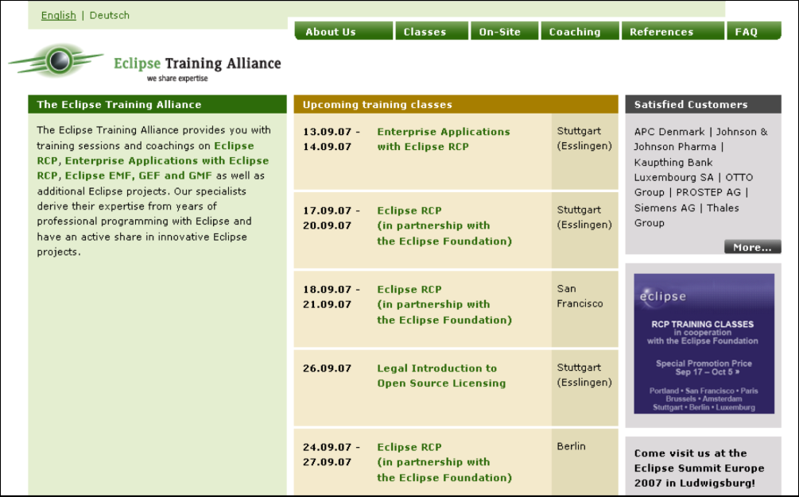
Eclipse Training Alliance: contact Europe
Please contact us for details:
Eclipse Training Alliance
c/o Weigle Wilczek GmbH
Dr. Jörn Weigle
Martinstraße 42-44
D-73728 Esslingen
Phone (+49) 711 45 99 98 0
Fax (+49) 711 45 99 98 29
www.eclipse-training.net

Slide 11

Eclipse Training Alliance: contact USA
Please contact us for details:
Eclipse Training Alliance
c/o Innoopract Inc.
Sanna Kaldner
351 NW 12th Avenue
Portland, OR 97 209
Phone (+1) 888 679 8753
e-mail skaldner@innoopract.com
www.eclipse-training.net

Slide 12
Who is everybody?
Java experience?
GUI programming with Swing/ AWT?
Experience with Eclipse as IDE?
Experience with Eclipse as a platform for riche client applications?
Other technical background?

Slide 13
Training philosophy
We teach the basic concepts and patterns
» Almost everything is learned by practice: "learning by doing"
» Approximately 40% theory, 60% practice
» Use Eclipse sources as an example
» Learn to work effectively in Eclipse IDE (shortcuts, tips & tricks)
» There are no stupid questions!

Slide 14

GMF Overview
“The Eclipse Graphical Modeling Framework (GMF) provides a generative component and runtime infrastructure for developing graphical editors based on EMF and GEF.”
Significantly reduces cost of DSL tooling
GMF is part of Eclipse Modeling Project
  Abstract Syntax development (EMF)
  Concrete Syntax development (GMF)
  Model transformation (QVT, JET, MOF2Text)
  Standards implementations (UML2, OCL, OMD, XSD)
  Technology & Research (GMT, MDDi, Query, Transaction, etc)

Slide 15
Why may GMF be of interest to me?
Feature-rich, extensible runtime
Bulk of GEF work done for you
Prefers models to code as a means to capture your domain-to-diagram knowledge
A lot of common diagraming tasks solved
Employs model queries and transformations
Tooling (generative framework) is evolving fast
DSLs are hot topic - just to warm up ☺

Slide 16
When should I consider GMF?
If you’ve thought about writing a GEF-based editor for your domain and would like to have it sketched fast
You’ve got a model, but don't feel comfortable with EMF editors
You need your editor to be extended by third-parties
You need to communicate your ideas graphically
You are familiar with terms like:
  [Link | Edge | Node | Connection | Compartment]
If you are eager to do GMF (and the whole world) better

Slide 17
When should I not consider GMF?
If you'd like to write yet another GEF-oriented framework to handle diagramming generically
  …and can afford man-years of labor required
You only need of static images with nodes & connections
You have tight restrictions on project size (to be addressed) or have “uncommon” requirements
Your project has a narrow scope/focus, and GMF is overkill
At present, you’re not ready to accommodate changes (critical projects)
  That is, until GMF is in stable release state
Notes:
“…uncommon requirements” – although some of them should be addressed in GMF – rise bug in Bugzilla

Slide 18
GMF Components
GMF has two main components:
  Runtime
    Binds EMF & GEF
    Provides service layer and significant diagramming capabilities
    Designed for extensibility
  Generation (tooling)
    Models used to define graphics, tooling, mapping to domain
    Code generation targets runtime
    Promotes use of Domain-Specific Languages

Slide 19
What is the GMF Runtime?
A set of frameworks to help the development of Eclipse graphical editors:
Reusable components for graphical editors
A standardized model to describe diagram elements
  Semantic and diagram models are distinct
Enables open and extensible graphical editors
Command infrastructure that bridges EMF and GEF
  EMF provides a runtime infrastructure to instantiate and manipulate models (among other things)
  GEF is an MVC-based framework to create graphical editors
Leverage various other technologies:
  EMFT-Transactioning
  EMFT-Validation
  EMFT-OCL
  Apache Batik

Slide 20
Overview: Platform, EMF, GEF, GMF
GMF-based Diagram
. . .
GMF Runtime
EMF
GEF
Contributed Extension
Provided Extension-Points
. . .
. . .
OSGi-based Eclipse Platform

Slide 21


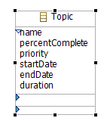
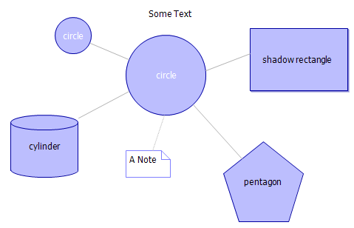
Reusable Components for Graphical Editors
Connection Handles:
Geometrical Shapes:
Action Bars:
Collapsed Compartments:

Slide 22
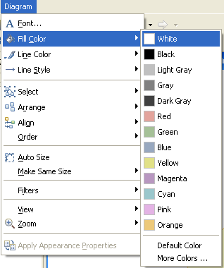
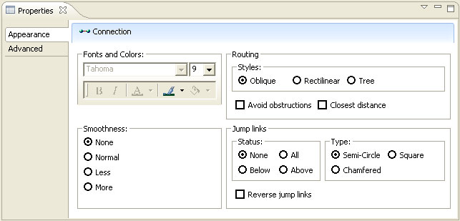
Reusable Components for Graphical Editors
Toolbar:
Actions:
Properties View:

Slide 23
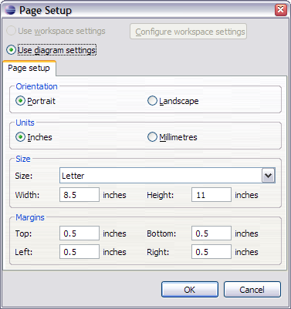
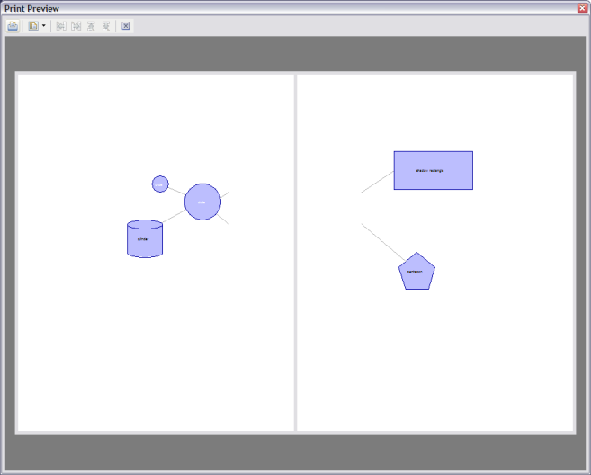
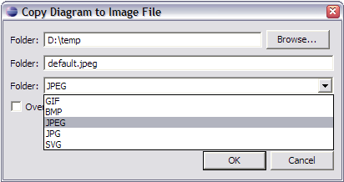
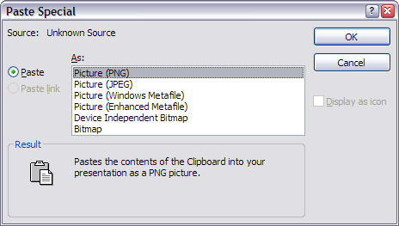
Reusable Components for Graphical Editors
Page Setup:
Print Preview:
“Copy Diagram to Image File” formats:
System clipboard formats:

Slide 24
Notation Meta-Model
Customized for team support
  Designed for minimal merge conflicts
Generic for representing different semantic domains
Customized for GEF (relative bendpoints, layout constraints)
Future extensibility
  Addition of new styles

Slide 25
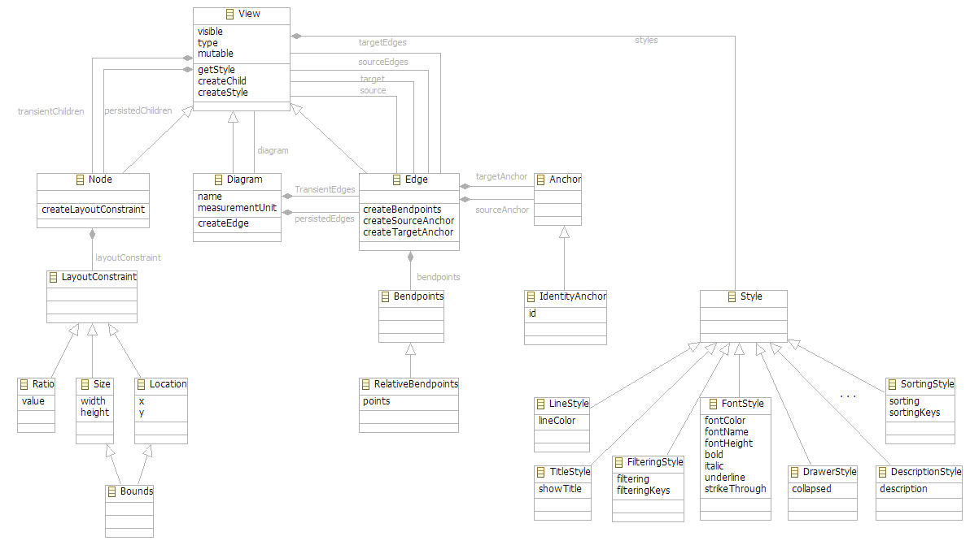
Standardized Model to Describe Diagram Elements

Slide 26
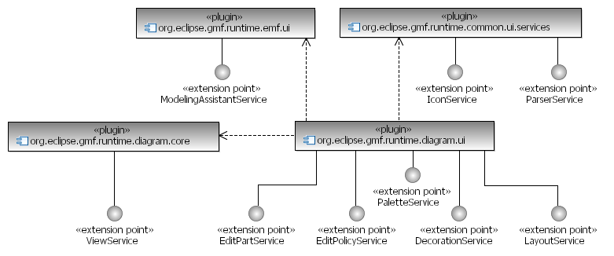
Services

Slide 27
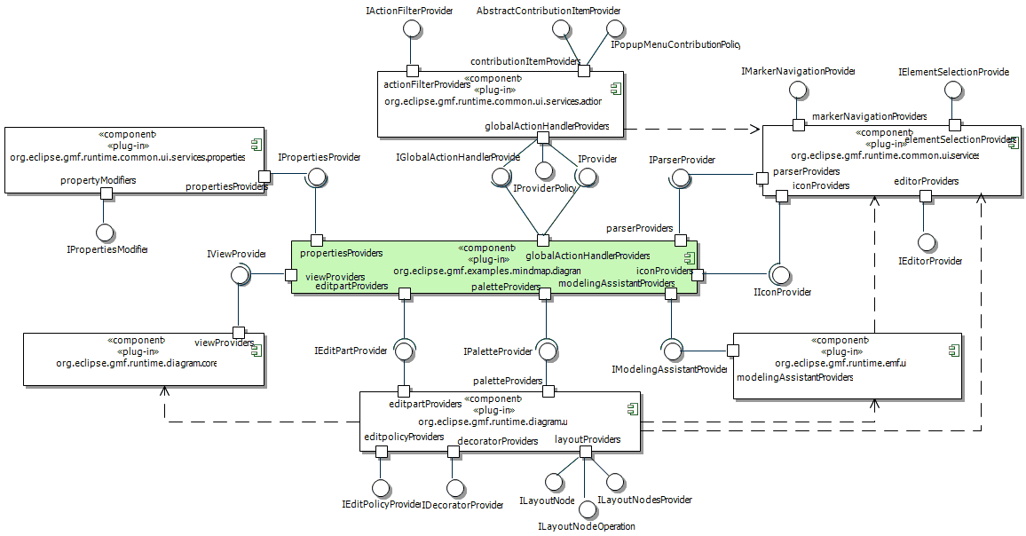
Generated Plug-in: Extension-Point Contributions

Slide 28
GEF – Model-View-Controller Architecture (recap)
Model
Controller
View
1- read
2- create
3- notify
4- update
Business
Model
GEF
Draw2D
java.lang.
Object
org.eclipse.gef.
EditPart
org.eclipse.draw2d.
Figure

Slide 29
GMF Diagram Architecture
Model
Controller
View
Business
Model
GEF
Draw2D
«semantic»
EObject
«notational»
o.e.g.notation.View
IGraphicalEditPart
figures
references
reads
listens
handles
creates/updates
manipulates
layouts
«notational»
commands
returns
editpolicies
understands
requests
routers

Slide 30
GMF Tooling
Set of models to define diagram editor - capturing graphical, tooling and meta-modeling aspects.
Extensible code generator, capable to customize generated code to match specific requirements
Transformation
Templates
Domain Model (ECore)
Generator Model (GMFGen)
Java code
Mapping (GMFMap)
Graphical Definition (GMFGraph)
Platform
Tool Definition (GMFTool)
GMF Runtime
Notes:
Describe the meaning of .gmfgen model
Highlight the possibility to modify existing transformation + code generation processes
Mention .gmfgraph model – this is a model of figures used by separated generator. This model could be extended as well.
Mention MDA techniques used in GMF
--- If we move in opposite direction, there’s another way to explain what GMF is: GMF is a combination of runtime layer, set of templates, configuration parameters for these templates (gmfgen model), and few additional models to describe, or to produce, that configuration.

Slide 31

Generation Overview
Develop
Graphical
Definition
*.gmfgraph
Create GMF
Project
Develop
Tooling
Definition
Create
Generator
Model
*.gmfgen
*.gmftool
Adjust
Generation
Parameters
*.ecore
Domain
Model(s)
Develop
Mapping
Definition
Generate
Diagram
Plug-in
*.gmfmap
*.diagram

Slide 32
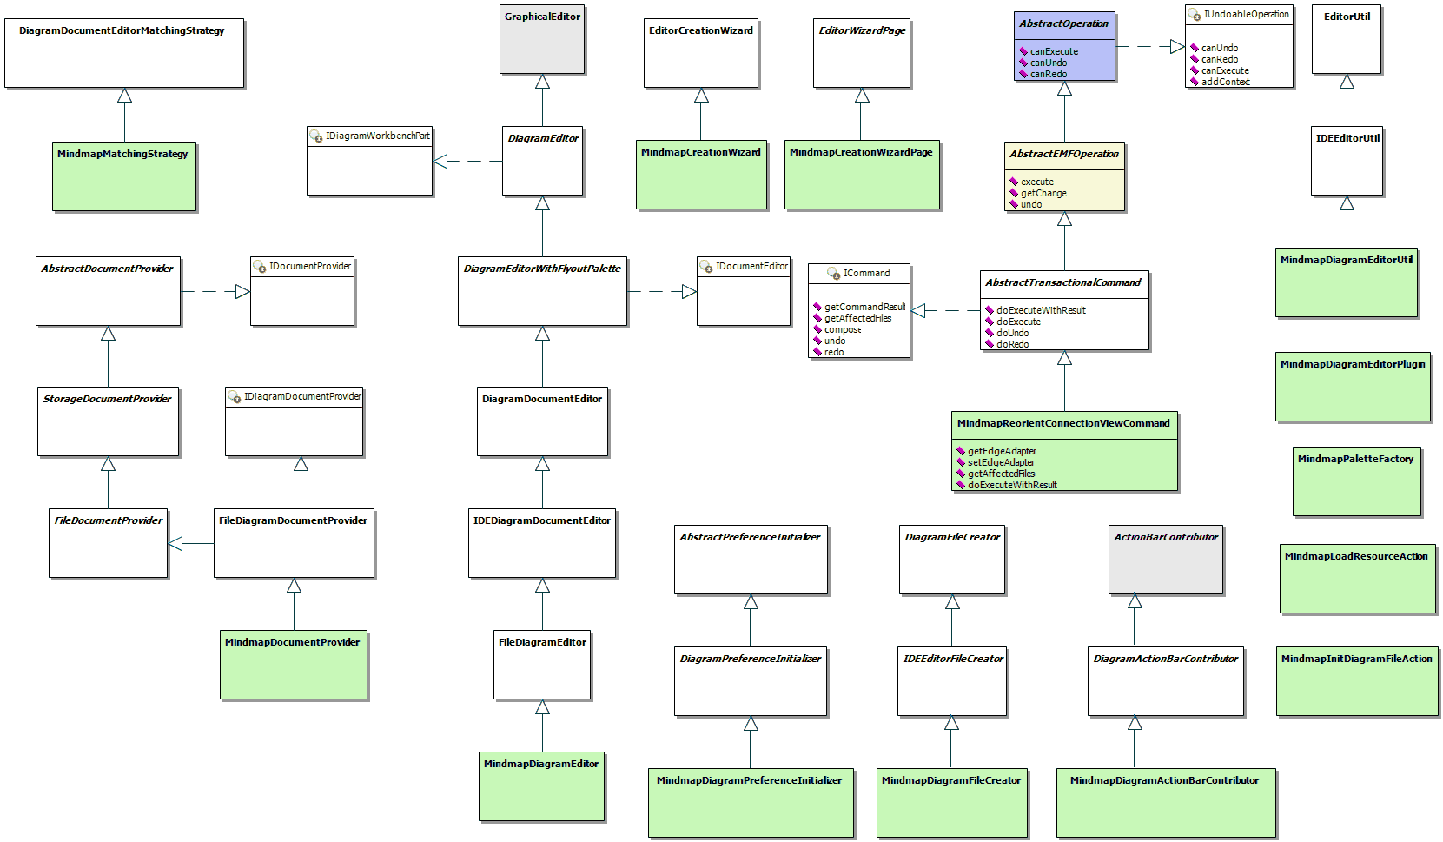
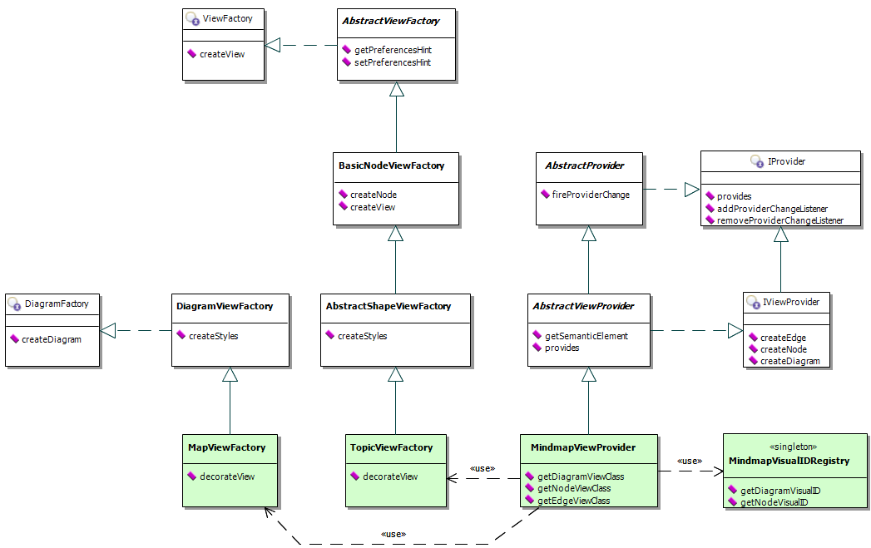
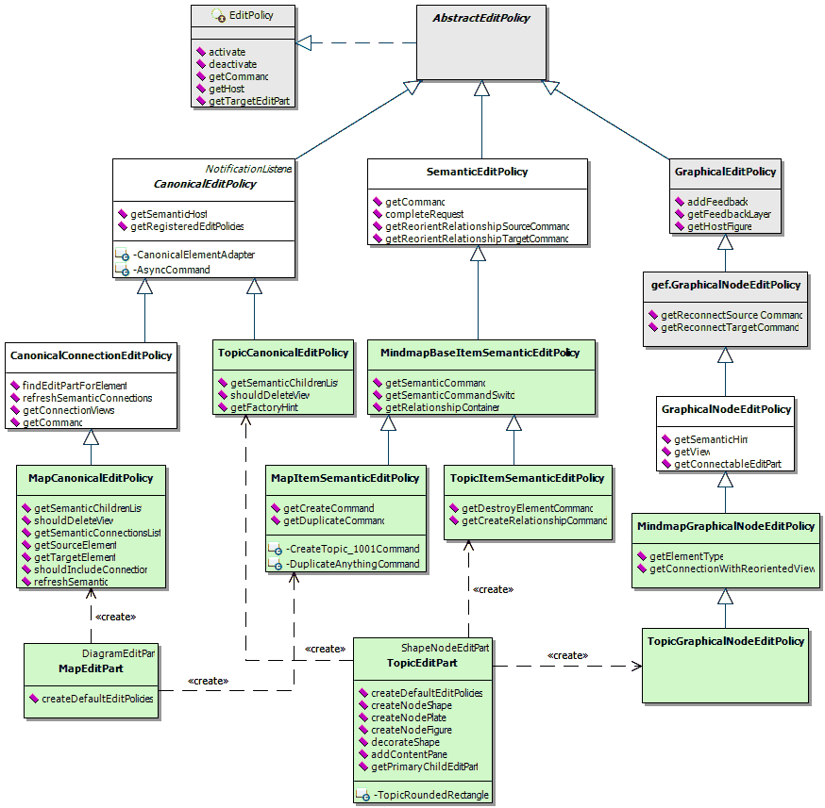
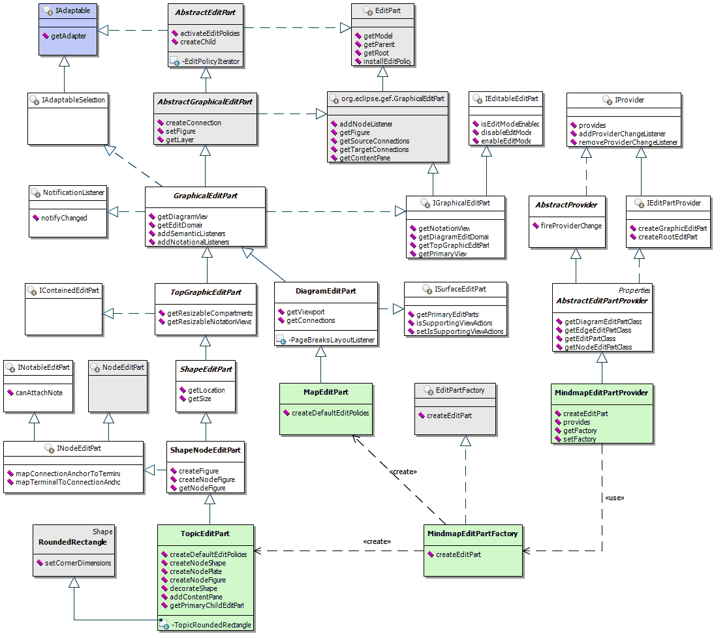
Generated Code
Editor, Plugin, etc.
View Provider
Generated
GMF Runtime
Edit Policy
Edit Part
GEF

Slide 33
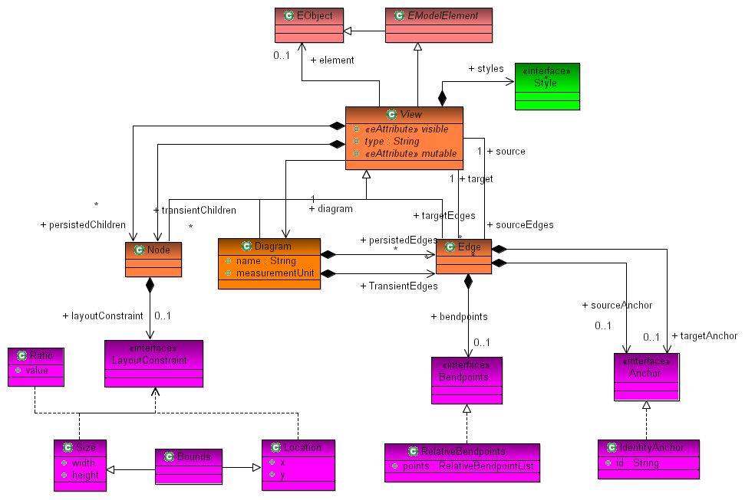
Notation meta-model core structure

Slide 34
Services
IconService: retrieve an icon based on an element type
ParserService: retrieve a parser for an element type
ModelingAssistantService: diagram assistant for a diagram
ViewService: retrieve view factory to construct view
EditPartService: gets the controller for a given view
EditPolicyService: allows installation of an editpolicy on existing editparts
PaletteService: definition and customization of palette drawers
DecorationService: decoration of a EditParts with adornments.
LayoutService: layout / arrange a diagram

Slide 35
GMF Runtime Extension Points
Notation Styles
  Extending visual diagram information by adding custom visual styles
Providers (Extension points)
  View
  EditPart
  EditPolicy
  ElementTypes
  Palette providers
  Parser
  Icon
  Diagram Layout
  Decorators
  ModelingAssistant
  Properties
  Global Actions
Notes:
Runtime extension point provide user with possibility to override or extend some part of generated diagramming functionality from the separate eclipse plug-in.
Runtime extensions will be queried on execution time this is why we are calling it “dynamic extensions”.
Final diagramming functionality will depends on full set of plug-ins installed into the current eclipse platform.
There are for basic types of Runtime extensions: “first”, “last”, “forward” and “Reverse”, each runtime extension has “priority” attribute. As a result the way to enumerate/choose one of the extensions will be controlled by “priority” property.
Generated code should use Runtime extension points for dynamic extensions only.
Then dynamic extensions are not required generator should non-extensible code to protect generated diagram from third-party extensions, improve generated code performance, remove unnecessary indirection (for example – to simplify debugging).
Currently generated code uses Runtime extension in most places but we are going to make this usage optional by introducing corresponding parameters into the generator model
Only one way to extend generated diagram content by some elements located in another plugin is to implement corresponding providers (left column) now.

Slide 36
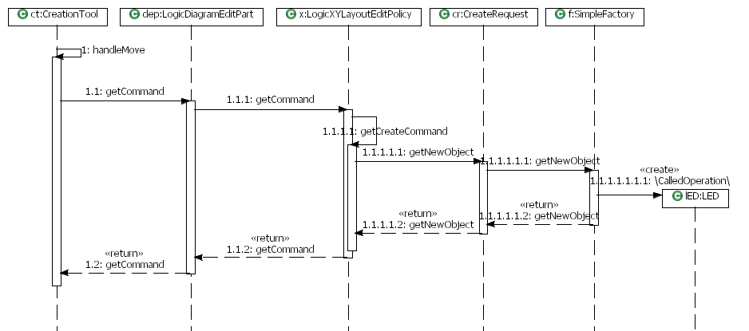
GEF: Shape Creation (Mouse Move)

Slide 37
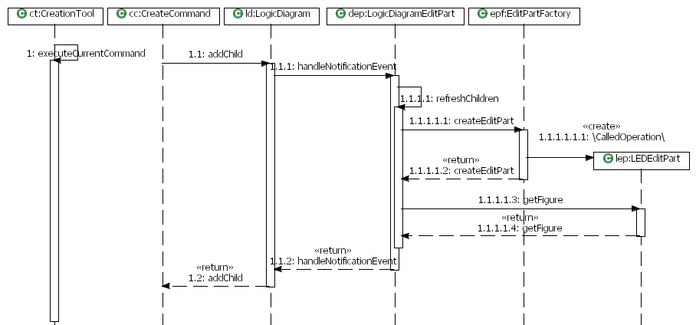
GEF: Shape Creation (Mouse click)

Slide 38
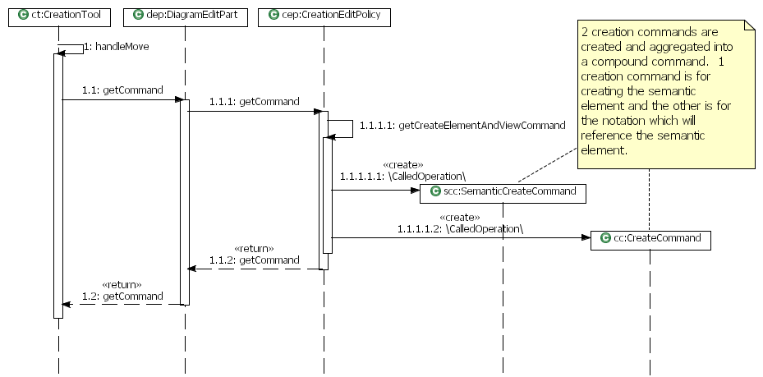
GMF: Shape Creation (Mouse Move)

Slide 39
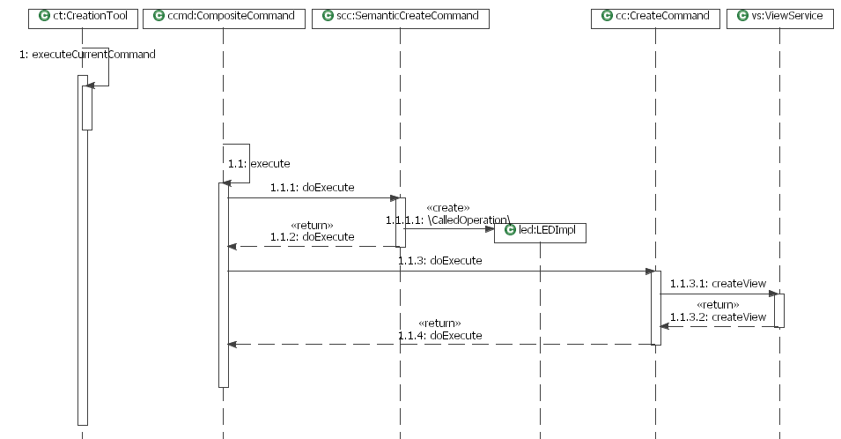
GMF: Shape Creation (Mouse Click – part 1)

Slide 40
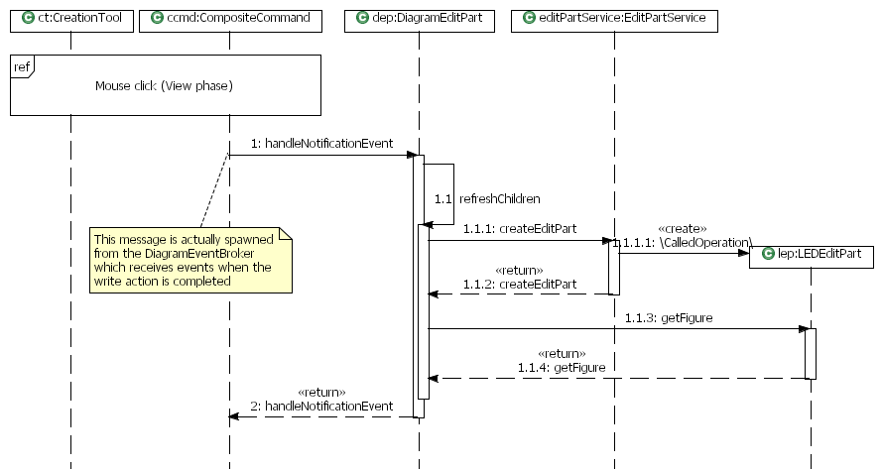
GMF: Shape Creation (Mouse Click – part 2)

Slide 41
GMF Advanced Topics
Points of variability in GMF
Frameworks vs. Factories
“Open” and “Closed” World Models
Examples

Slide 42
Variation points
Domain Model (ECore)
Generator Model (GMFGen)
Java code
Mapping (GMFMap)
Graphical Definition (GMFGraph)
Platform
Tool Definition (GMFTool)
GMF Runtime
Templates
Code
Models
Extension points
Transformation

Slide 43

Variation points
Code
Extension points
Templates
Model
  Arguments or values specified in a model
  Extended models
  “Annotated” or decorated models
  Transformations
Notes:
Start with Logic Example and override every single piece to look and behave differently
Extension points - Implement Runtime interfaces to plug in dynamic extension to the generated diagram.
Templates: Mention dynamic templates for both gmfgen and gmfgraph.
USE OF TEMPLATES TO DEFINE ABSTRACT CLASSES – WHERE TO PUT THIS???
Models. Arguments – Kinda design-time variability. Modify generator models to change code generation parameters.
Models. Decorated and Transformation - Use MDD techniques to customize generated code.
QUESTION THE AUDITORIUM
HOW MANY OF YOU KNOW WHAT XPAND IS
HOW MANY OF YOU DID CHANGE EMF OR GMF TEMPLATES

Slide 44

Framework “completion” code
Fast - all you need to do is to fill blanks in the half-done puzzle
Well thought out
Complex
Certain pieces can’t be
replaced at your discretion
Decoupled
quite often
Notes:
Rather inserting fragments into a half-done puzzle. You've got a picture, and allowed to fill the blanks.
Definitely, this works faster for thought-in-advance scenarios, but what if you need to do something differently.
Another point is that certain pieces of a framework can't be replaced on your discretion (only those intended to be replaced by fwk designer, who might not be aware of your specific use-case). Not each of you need to build full-blown customizable uml modeling tool, and sophisticated limousine might not be the right choice.

Slide 45

Model-backed Factory
Think assembling suitable pieces to form a whole
Boilerplate code
Flexible
You’re on your own
who cares once generator does the most?
but only smart do GMF, right?
Notes:
Flexible – no one can prevent you from planting a tree at your spaceship. Almost no bounds except your own creativity.
Complexity - fwk helps one get rid of some boilerplate code, at expense of (few) additional layers of abstractions. Sure it pays off when coding by hands, but do we care when generator does this for us? Besides, fwks are faster when you are well acquainted with them, and it's all good if your primary job is designing diagrams with gmf. However, the promise of gmf is that it should be easy to get a diagram for whatever domain, and I bet that domain is your primary interest, so you are not going to become a GMF expert for living.
On your own – I mean, you can do whatever you like with the factory, e.g. we can’t prevent nor stop you from having planted a tree at your spaceship.

Slide 46
“Open” and “closed” worlds
Runtime environment where GMF editor plug-in is deployed
  Hostile environment, with other plug-ins that utilize GMF flying around, trying to plug into your so-nice-looking editor.
  Statically binding with Java code
  Dynamically composed at run time via extensions
Development environment
  Diverse team
  Debug
Notes:
imagine, once you develop your gmf editor, it gets into hostile (TODO hazard image?) environment, with other plugins utilizing gmf flying around and trying (unintentionally, of course) to plug into your so-nice-looking editor. Would you like to get unexpected items in your diagram palette just because some gmf novice didn't figure out how to configure services/providers right?

Slide 47
Summary
There are few different ways to augment your GMF editor
Modification approaches range from simplest, “point-and-type” to sophisticated, MDD-style techniques
There’s no single best way.
Your product or development requirements mandate use of specific approach
  Dynamic
  Custom deployment
  Sharing artifacts between teams
  <you name it>
GMF is open, do it the way you like

